Slide 1
Kinetics in Rigid Body Translational Systems
Dr. Jacob Moore
Associate Professor of Engineering
Penn State Mont Alto

Slide 2
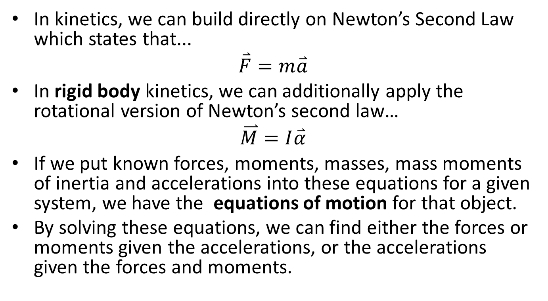
Newton’s Second Law and Kinetics
In kinetics, we can build directly on Newton’s Second Law which states that...
$$\overset{⃑}{F}=m\overset{⃑}{a}$$
In rigid body kinetics, we can additionally apply the rotational version of Newton’s second law…
$$\overset{⃑}{M}=I\overset{⃑}{α}$$
If we put known forces, moments, masses, mass moments of inertia and accelerations into these equations for a given system, we have the equations of motion for that object.
By solving these equations, we can find either the forces or moments given the accelerations, or the accelerations given the forces and moments.

Slide 3
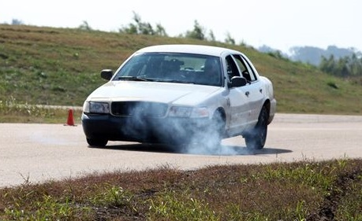
Translational Systems
Despite the sum of moments being equal to zero like a statics problem, the forces are often quite different from a static system
An example of this is a car under heavy braking, where the normal forces shift in order to balance the moment the friction forces exert about the center of mass.

Slide 4
Solving a Rigid Body Kinetics Problem (The Process)
The process used in solving a kinetics problem is similar to solving a problem in statics and consists of three steps.
Set up a free body diagram.
Draw the body separated from its surroundings
Draw in all the known and unknown forces (I use red for forces) as well as key dimensions and angles (I use blue for dimensions and angles)
Draw in the acceleration vectors (I use a blue dashed vector for this)
Use the free body diagram to write out your equations of motion, breaking all forces down into x and y components, and writing out all the moments about the center of mass of the body.
The sum of moments will be equal to zero for translational systems
The equations of motion may be supplemented with kinematics equations to relate the accelerations
Solve the equations for any unknowns.

Slide 5
Thanks for Watching
See other engineering mechanics videos and access the full tool at…

Slide 6
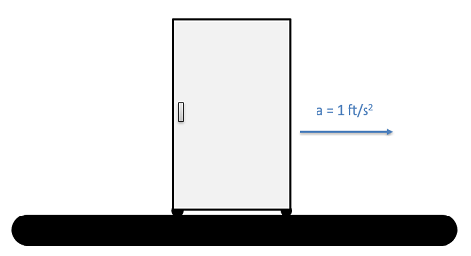
Worked Example
A refrigerator is 2.5 feet wide, 6 feet tall and weighs 80 lbs. The center of mass is 1.25 feet from either side and 2 feet up from the base. If the refrigerator is on a conveyor belt that is accelerating the fridge at a rate of 1 ft/s², what are the normal forces at each of the feet?

Slide 7
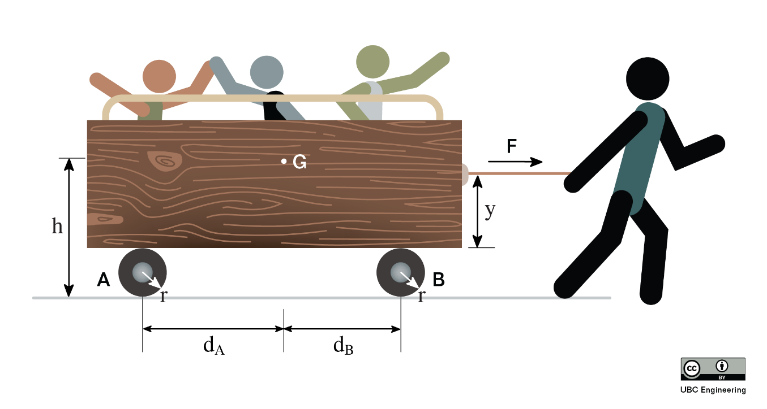
Worked Example
You are forced to pull a group of kindergarteners in a cart. If you apply a horizontal force of F=600 N, determine the normal force on its wheels. The cart has a total mass of m=160 kg and has a center of mass at G. Assume the wheels have negligible mass. Wheel A has a radius of 0.2 m and is a horizontal of d_{A}=0.89 m from G. Wheel B has a radius of 0.2 m and is a horizontal distance of d_{B}=0.39 m. You apply the horizontal force at a height y=0.5 m from the bottom of the cart. The center of gravity of G is located at a height h=1.1 m from the ground.

Slide 8
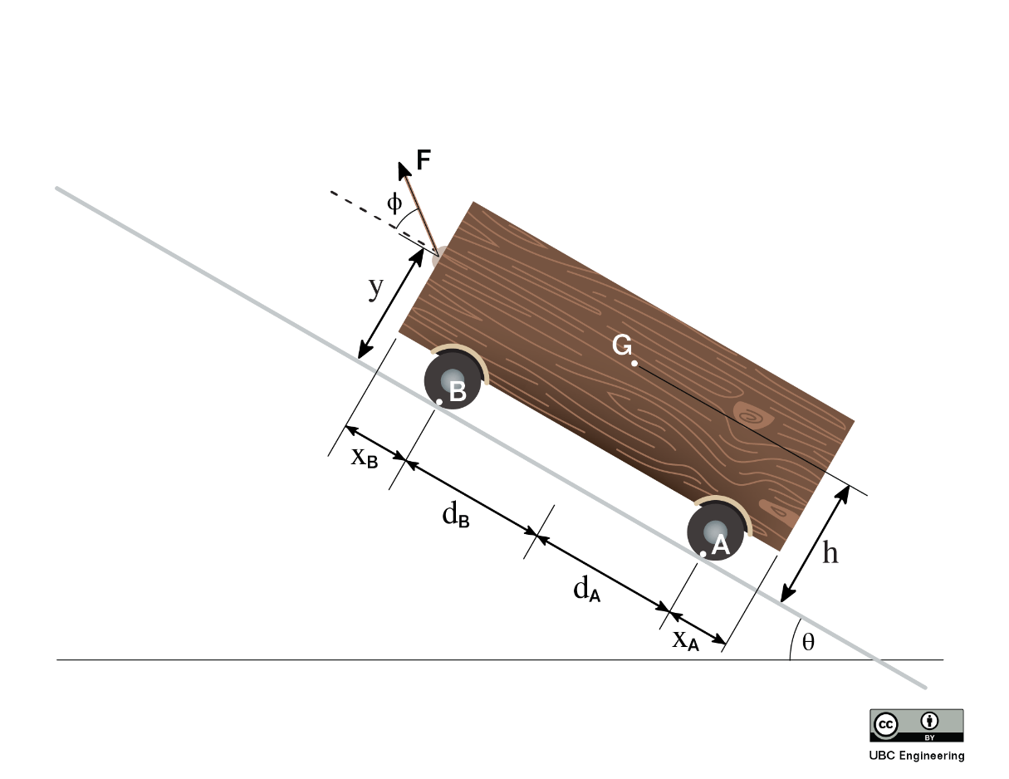
Worked Example
You are hauling a heavy cart up a θ=30 deg incline. Luckily, you have been working out so you can apply a force of F=500 N to the cart. If you apply this force at an angle ϕ=42 deg and the cart has a mass of m=30 kg, what is the acceleration of the cart and the normal force on each of the cart’s wheels? The cart has a center of gravity G. The force is applied at a height y=0.4 m from the ground and G is located at a height h=0.5 m. Wheel A is located x_{A}=0.1 m from one side of the cart while wheel B is located x_{B}=0.05 m from the other end. Wheel A is a distance d_{B}=0.3 m from G while wheel B is a distance d_{B}=0.25 m.

Slide 9
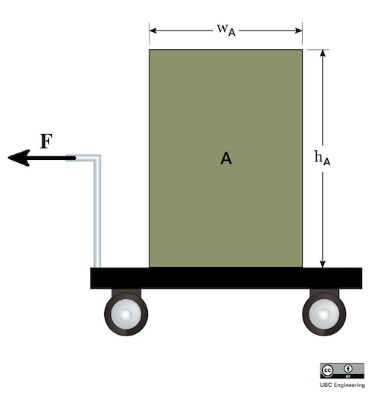
Worked Example
Your very wonderful parents have returned from their vacation from Hawaii while you were studying for midterms. At the airport, you stack their luggage, which can be modelled as box A. Box A has a width w_{A}=0.5m and height h_{A}=0.8m. If box A has a mass m_{A}=50kg, determine the maximum force F you can apply on the 12kg car before tipping their luggage over. Assume slipping does not occur and that box A has uniform density even though clothing is probably stuffed in all sorts of places to save space for souvenirs.

